Slide 1
Capstone Predicting stock price movements with text analysis
General Assembly – DSI 9
Gabriel Perez Prieto

Slide 2


Agenda
Problem Statement
Data Collection and Cleaning
Preprocessing
Methodology
Next Steps
Results
Feature Engineering
Notes:
Problem Statement
Data & EDA
Preprocessing
Methodology
Model Selection
Conclusion & Next Steps

Slide 3

Problem Statement
Is it possible to predict stock price movements based on SEC filings - Using Natural Language Processing ?

Slide 4



WHY? And Interested Parts
Personal interest:
Finance
Stock Market
Investments
Banks
Hedge Funds
Wealth Management Firms
Individual Investors

Slide 5
Concepts
Form 8-K:
Is the “current report” companies must file with the SEC to announce major events that shareholders should know about.
Efficient Market Hypothesis:
Stock prices reflect all available information

Slide 6
Data Collection
Links for Filings
Parse HTML and Get Text
Stock Prices
SP500 Info
Data Collection:
All Companies in the S&P 500
SEC Database
2011 – 2019
63,659 documents
Yahoo Finance – Stock Prices
Data Cleaning:
Parse Documents
Duplicates
56,911 documents

Slide 7
Data Collection

Slide 8
Data Collection

Slide 9


Feature Engineering
Business and Operations
Financial Information
Corporate Governance and Management
Other Events
Regulations
Historical Returns |
VIX
Filings and Types
Sector and Sub-Industry
Modeling
Past Performance:
Day
Week
Month
Year
Volatility Index
( Release Date )
Sector: I.T.
Sub-Industry:
- Systems Software
Semiconductors
Internet Services
Etc.

Slide 10
Preprocessing - Text
Remove
Stop Words
Remove Punctuation
Lemmatize
Words

Slide 11
Preprocessing – over sample
Random Over Sampler
Over Sample
Training Data
Over Sample
Training Data
68.24%
15.41%
16.34%

Slide 12
Modeling Methodology
Pipeline + Randomized Search
Column Transformer:
Categorical Features:
Processed Text – Term Frequency Vectorizer ( TF – IDF )
Numerical Features:
Past Performance – Standard Scaler
Sector / Industry – Get Dummies
Items – Multilabel Binarizer
Classifier:
Logistic Regression

Slide 13
Results
66.35%
67.42%
57.14%
57.70%

Slide 14
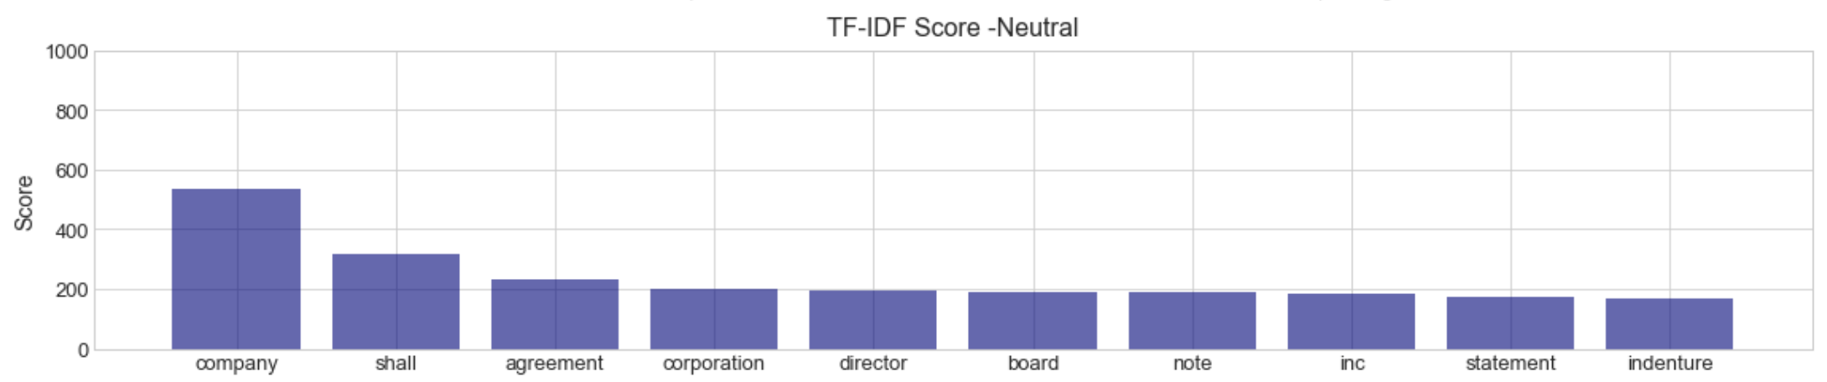
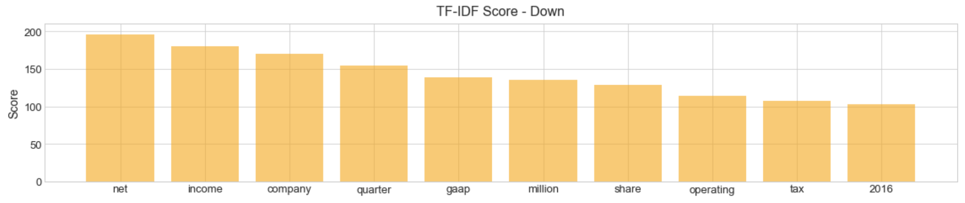
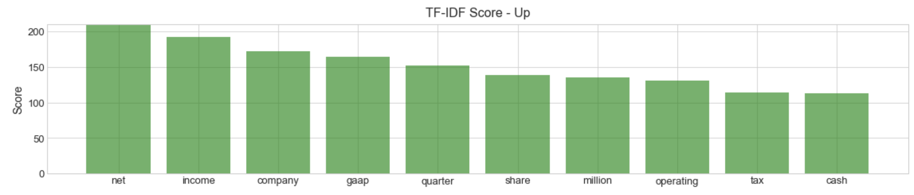
Most Common Words

Slide 15
Feature importance - UP
Volatility of the Market

Slide 16
Feature importance - DOWN
Modification to Rights of Security Holders
Financial Statements and Exhibits

Slide 17
What if? - Industry Specific

Slide 18
Conclusion
Is it possible to predict stock price movements based on SEC filings - Using Natural Language Processing ?
It is possible to get a slight edge on short-term trades
Understand what types of documents and its probable impacts
Improvement from a 33% random guess to 57% test accuracy
Better results on Industry Specific Models

Slide 19
Next Steps
Limitations:
Computational Power – Fine Tune Models
Time – Analysis Only Touches the Surface
Next Steps:
Stop Words - Finance
Include News from Twitter
Include Treasury Bonds Yields
Time Series model
Explore more in-depth modeling in TensorFlow - Keras
Embedding + CNN / RNN / LSTM / GRU
New Model with Sense2vec

Slide 20

Thank you !
Questions ?

